Slide 1

Monthly Members Meeting
May 25th, 2021

Slide 2

Welcome!

Slide 3
Agenda
Welcome & Introductions
McKinney-Vento Program
SOAR (SSI/SSDI Outreach, Access, and Recovery)
for Adults Orientation
2021 Hurricane Season Update
Announcements
Unsheltered Count Tutorial

Slide 4
McKinney-Vento Program
Danielle Batista

Slide 5
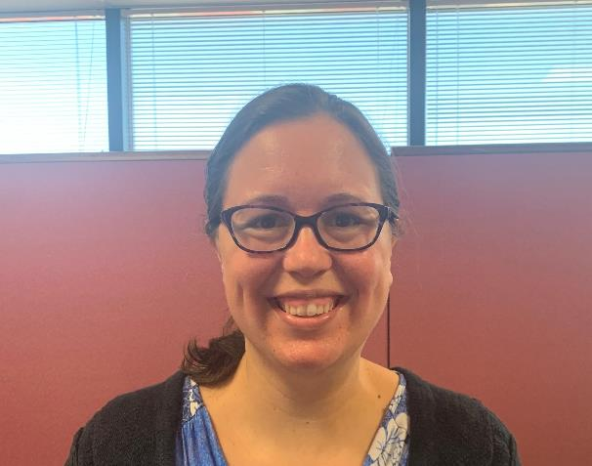
Introduction
Danielle Batista
District Liaison,
McKinney-Vento Program,
Orange County Public Schools

Slide 6
    “We think sometimes that poverty is only being hungry, naked, and homeless. The poverty of being unwanted, unloved, and uncared for is the greatest poverty. I have come more and more to realize that it is being unwanted that is the worst disease that any human being can ever experience. We must start in our own homes to remedy this kind of poverty.”
    Mother Teresa (1910-1998)

Slide 7
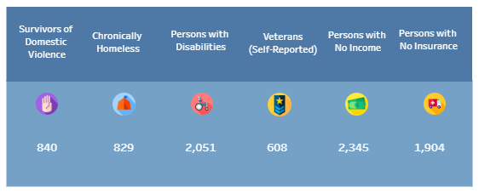
CENTRAL FLORIDA
5,180 residents of Orange, Osceola, and Seminole county meet this “literal” or HUD’s (Housing and Urban Development) definition of homelessness.
This DOES not count
those living in hotels.
Notes:
Discuss literal definition of homelessness and these are the current counts (from CFCH data website in March).

Slide 8
How do we define homelessness in education?

Slide 9
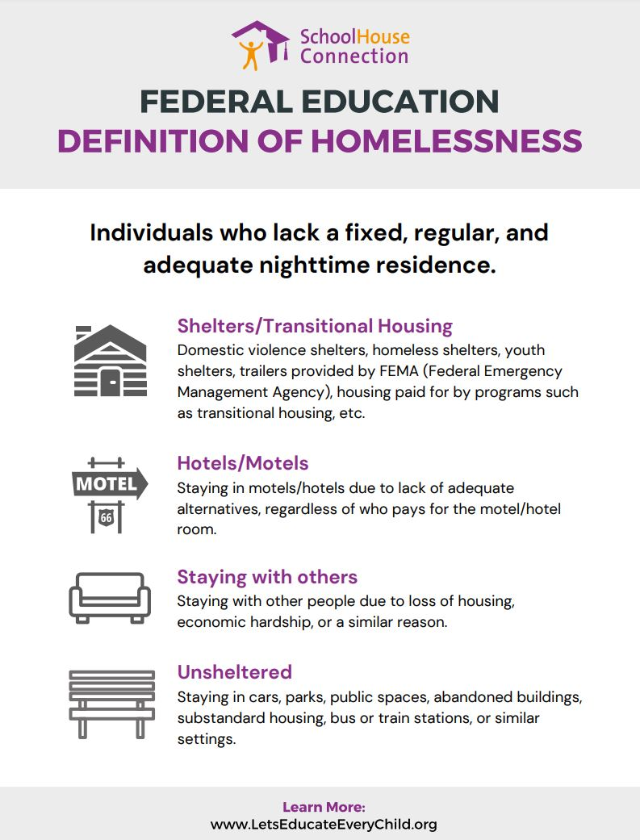

Slide 10

McKinney-Vento Act
1987- Signed into law
1990 - Elimination of enrollment barriers is added
1994 – Pre-school services is added
2002 – All districts required to have a local liaison
2015 – Act reauthorized under ESSA and feeder patterns added to school of origin rights

Slide 11
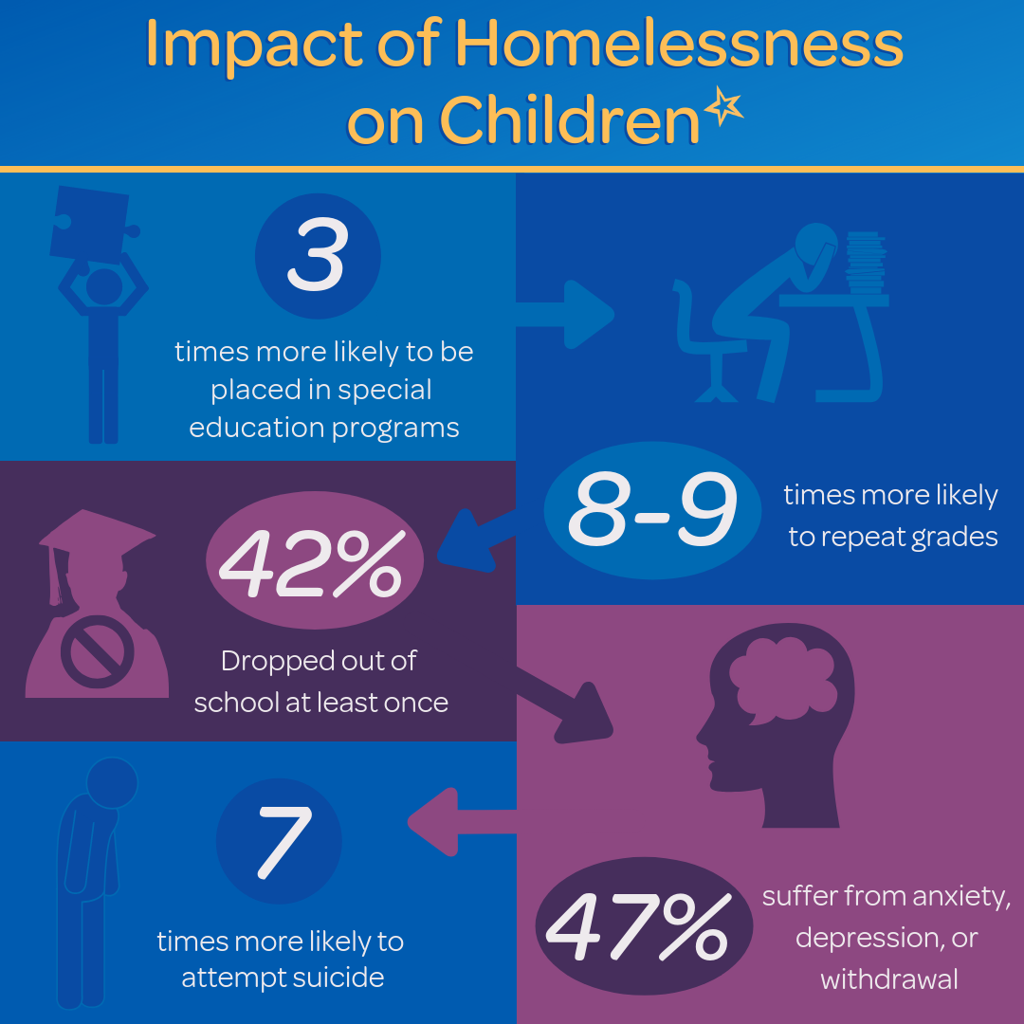

Slide 12

Notes:
Stability is the main purpose of the McKinney-Vento Law, this is the whole reason why the law was created. Since we know the definition of homeless in education is, not your typical image, we want to remove that misconception from our minds. In reality, our families working minimum wage jobs most likely qualify for MVP services. These are the students that need the stability the most.
In order to help these students, stability is needed. Students are moving around from place to place, which makes learning difficult. Education and breaking the generational cycle of homelessness is where our work comes in. We have to ensure that students receive additional supports to succeed in school.

Slide 13
Today’s Reality

Slide 14



Who Do We Serve?
Notes:
Today’s reality of homelessness as defined by the McKinney-Vento act is not your typical image.
Who Do We Serve?--These are students that have parents serving at restaurants, baristas, cashiers, theme park workers, hotel workers.
With the reality of minimum wage not providing enough to cover rent and living costs, families with children have to make decisions to help keep a roof over their head and support their children to maintain stability. Families that work minimum wage/hourly jobs most likely qualify for MVP services.

Slide 15

Notes:
Discuss with participants that currently minimum wage does not meet the cost needed to rent a two bedroom home. A single parent working minimum wage will more than likely qualify under MVP.
In Florida, Minimum Wage is a topic of discussion in November’s Election; the reality is that the full effect will take place in 2026.
Could rent costs increase by 2026? Could the cost of living go up?
The sad reality is that our families that cannot afford rent and/or earn minimum wage may be eligible for MVP.

Slide 16
OCPS Data
Notes:
63% of MVP students are doubled-up/sharing housing (Minimum wage is not enough to afford rent)

Slide 17
HOW DOES ORANGE COUNTY MVP ASSIST STUDENTS?

Slide 18
Notes:
Stability is the main purpose of the McKinney-Vento Law, this is the whole reason why the law was created. Since we know the definition of homeless in education is, not your typical image, we want to remove that misconception from our minds. In reality, our families working minimum wage jobs most likely qualify for MVP services. These are the students that need the stability the most.
In order to help these students, stability is needed. Students are moving around from place to place, which makes learning difficult. Education and breaking the generational cycle of homelessness is where our work comes in. We have to ensure that students receive additional supports to succeed in school.

Slide 19
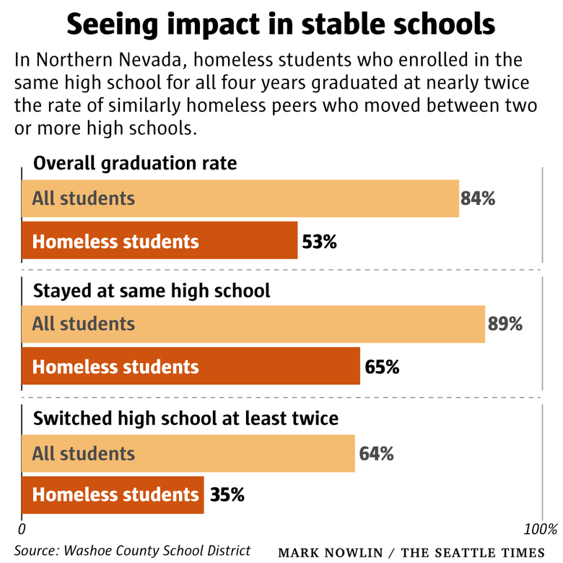

Slide 20
McKinney-Vento Act Rights
School Stability
            Zoned school and School of Origin
            Transportation
            Over 2 miles.
School Enrollment
No deadline to receive forms.
Immediate enrollment includes digital learning (priority in device distribution).
Immediate includes transportation (call our office for support) – bus passes or gas cards while bus is being routed.
Free Meals
Starts on day one, can provide Student Residency Questionnaire to cafeteria manager
Automatically in system for free lunch the day after coded in Skyward

Slide 21

Unaccompanied Homeless Youth (UHY)
If legal parent/guardian is experiencing housing transition, child is not with parent/guardian students can be listed as Unaccompanied Homeless Youth or UHY.
All MVP rights and some additional rights and allowances may apply.

Slide 22
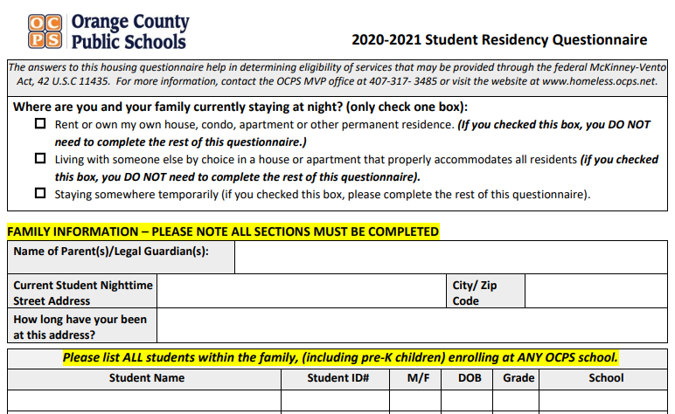
Residency Questionnaire
Families must re-enroll every school year.
Retain rights for the entire school year (even if the student moves to permanent housing).
Residency Questionnaire completed by family or school or district staff member.
Digital Residency Questionnaire

Slide 23

District MVP Office Support
Advocacy: MVP Status certification and assistance in ensuring rights are provided.
Kids’ Closet: Clothing, hygiene items, food, school supplies – DONOR SPONSORED
Field Trip fees: (up to $25 per student) on a first come, first serve basis
Activity fees: (up to $75) on a first come, first serve basis, course related
Cap and Gown Fees
Referral to community resources
AWARENESS TRAINING

Slide 24
DONOR SUPPORTS
Orange Technical College
Hotel to Permanent Housing Project
Free tuition for parents of OCPS MVP students
Free tuition for MVP graduates of OCPS up to age 21.
Fees and books covered for all OCPS students dual enrolled
First month and deposit provided
  Parent of OCPS student must have a job showing they can make the monthly rent payment.
  Parent of OCPS student must find an apartment or landlord that will rent to him or her.

Slide 25
HOW CAN YOU HELP?
Awareness
  Direct families to call or email our office - helphomeless@ocps.net or 407-317-3485 or complete the survey at https://tinyurl.com/ocpssupports
  Share our promo video - https://www.youtube.com/watch?v=GT9yEfi_fcw&t=16s
Donations
  Clothing – Underwear, socks, shoes, trendy clothes for all sizes. New preferred, gently used also accepted. Email helphomeless@ocps.net if you have donations.
  Financial – Click here and select OCPS Homeless Foundation Fund

Slide 26
Migrant Education Program (MEP)

Slide 27


Migrant Education Program (MEP)
MISSION: To help migrant students and youth (ages birth to 21) meet high academic challenges by overcoming the obstacles created by frequent moves, educational disruption, cultural and language differences, and health-related problems.
Notes:
The goal of the Migrant Education Program is to ensure that all migrant students reach challenging academic standards and graduate with a high school diploma (or complete a GED) that prepares them for responsible citizenship, further learning, and productive employment.

Slide 28
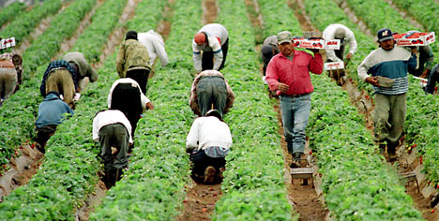
What is a “Migrant” student?
What does the word migrant mean?
Migrant means “to move”
In education this is not necessarily a person who has IMMIGRATED from another country.
Migrant students are those who work or have family members that work in agriculture and move due to harvest.

Slide 29
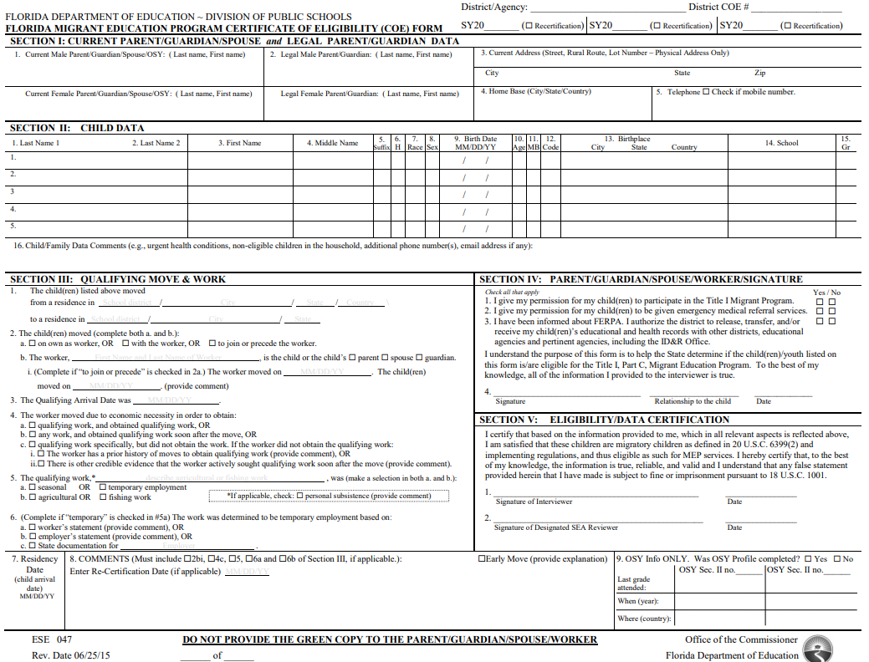
How does a family qualify?
Qualifying move within the last 36 months
Working in the field of agriculture or on dairy or fish hatchery farm
Complete a valid Certificate of Eligibility
  This can be used for enrollment
Notes:
Review qualifications
Review COE and how it can be used in place of other documentation for enrollment at school

Slide 30
GOALS of MEP
Succeed in the regular school program
Meet challenging state academic content and standards
Graduate from high school

Slide 31
OCPS District MEP Supports
Recruitment
  Present and/or attend events to share the program with families, school staff, community groups
  Communicate with families to see if they qualify for the program
    Must have a qualifying move within the last 36 months
Advocacy
  Communicate with families on a monthly basis at minimum
  Act as a liaison between schools and the family
  Assist in translation and understanding of school operations
  Assistance with school enrollment
  Provide community referrals and supports as available
Notes:
Talk about our team supports in three ways – recruitment, advocacy, and instruction

Slide 32
HOW CAN YOU GET HELP?
  HELPHOMELESS@OCPS.NET
  407-317-3485

Slide 33
CONTACTS - MVP
Mainline: 407-317-3485
Website: homeless.ocps.net
District MVP Liaisons:
(407)317-3200
Danielle Batista: x 200-2789
Bernice Mendez: x 200-2815
Jasmin Reyes Baerga: x 200-4594
Natasha Paul: x200-2032

Slide 34
SOAR (SSI/SSDI Outreach, Access, and Recovery) for Adults Orientation
Colleen Cantin

Slide 35

SOAR (SSI/SSDI Outreach, Access, and Recovery) for Adults Orientation
Substance Abuse and Mental Health Services Administration
(SAMHSA) SOAR Technical Assistance Center
Policy Research Associates, Inc.

Slide 36
What is SOAR?
A model for assisting eligible individuals to apply for Social Security Administration (SSA) disability benefits
For individuals who are experiencing or at risk of homelessness and have a serious mental illness, co-occurring substance use disorder, or other physical disabilities
Sponsored by SAMHSA in collaboration with the Social Security Administration (SSA) since 2005
All 50 states and Washington, DC currently participate

Slide 37
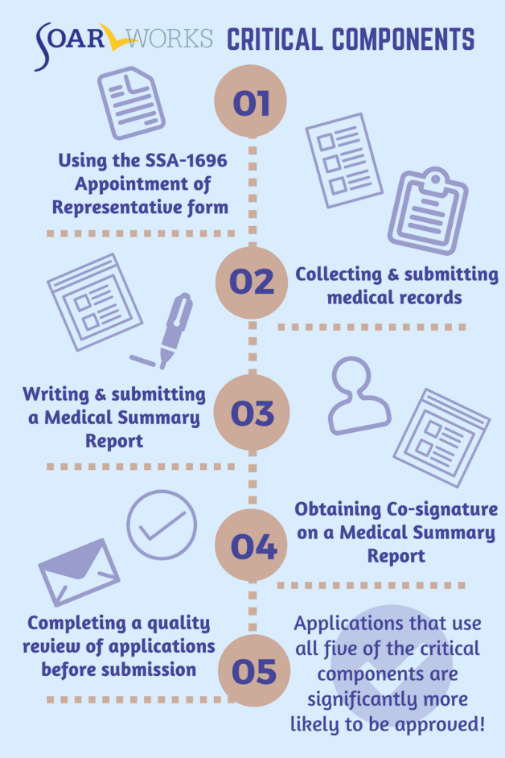

What Makes SOAR Unique?
SOAR-trained case workers are the heroes!
Notes:
National Average days to decision 115
Appeals is 211

Slide 38

Benefits of the SOAR Online Course
Standardized training provided across all geographic areas
SOAR Leaders can coordinate follow-up training and support
Course is FREE, web-based, and self-guided
20 CEUs from National Association of Social Workers (NASW)

Slide 39
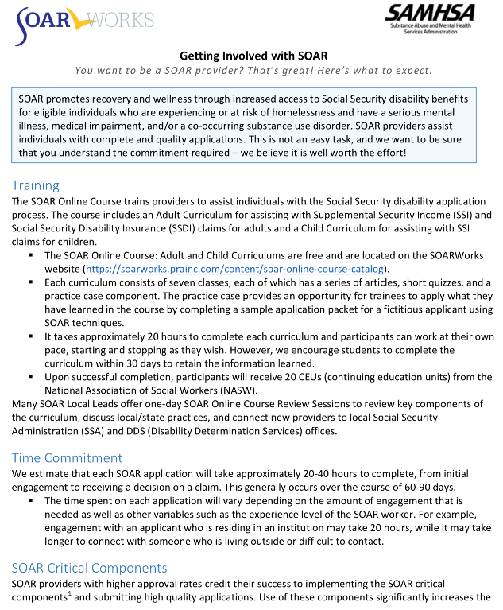
Getting Involved: Time Commitment
Training: 20 hours
20-40 hours per complete application
SOAR Critical Components
Outcome Tracking
Benefit to Your Agency and the Individuals You Serve

Slide 40
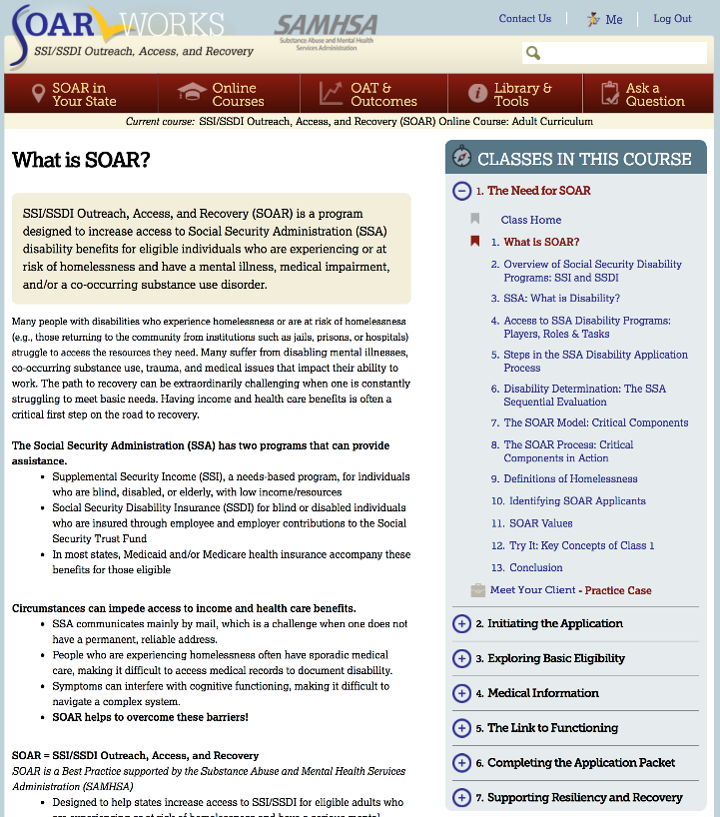
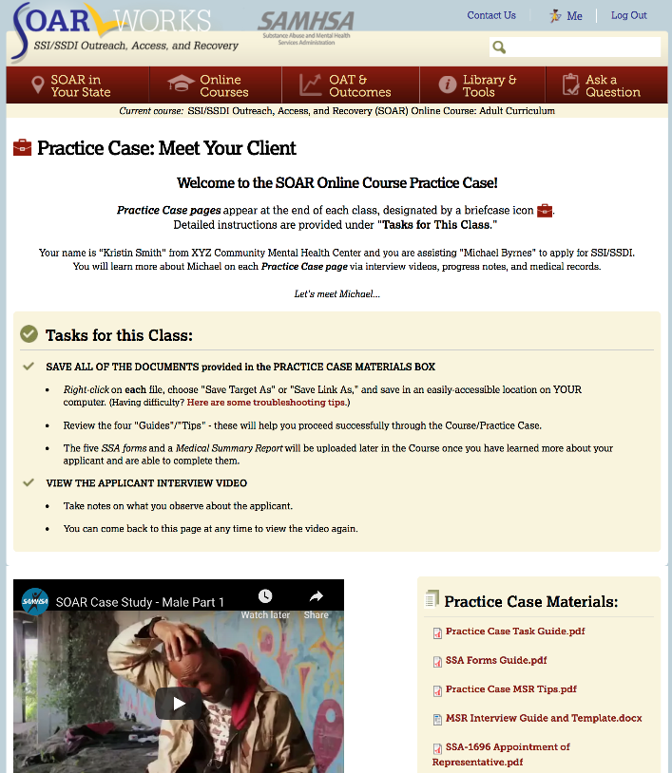
SOAR Online Course: Articles and Practice Case
Articles and Content
Practice Case
Notes:
Articles v Practice Case files
7 Classes that cover everything from the basics of SSI/SSDI and SOAR to Work Incentives
Unique Practice Case Component – trainees complete an SSI/SSDI application packet for a fictional applicant

Slide 41
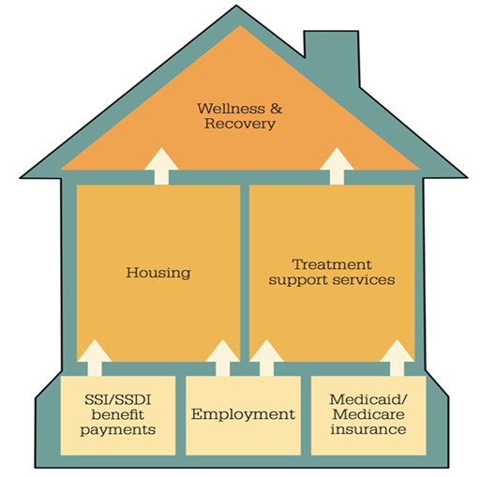
Things to Remember
Yes, the application process is complex. SOAR outlines each step of the process with great details. The SOAR local lead is also available to guide you through.
A standard application is expected to take over 365 days. Florida’s average days to decision is 115 days.
The average back payment is $6,821.
Individuals experiencing homelessness receive a homeless flag.
The process may take time- but so does waiting on a waitlist.
SOAR is more than access to income; Access to health care and housing; Increased education and employment opportunities; Decreased incarcerations and hospitalizations.
The SOAR TA center offers a HIPAA compliant outcomes tracking system that can be utilized for advocating for funding.
Notes:
Your client’s opportunity remains in your power & not a referral source agency.

Slide 42
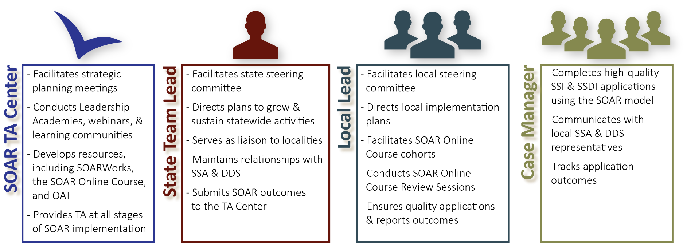
SOAR Leadership Structure
*OAT: Online Application Tracking Program
*DDS: Disability Determination Services
*TA: Technical Assistance
Notes:
Be sure to mention that case managers might have an agency lead that uses OAT and helps supervise multiple case managers
All these players are ambassadors for SOAR Initiative – united in ending homelessness for individuals with disabling conditions

Slide 43
Next Steps
Learn more about SOAR on June 22nd.
Contact your local lead, Colleen Cantin.
  CCANTIN@CFCHS.ORG
  407-985-3566
Register for the SOAR Online Course.

Slide 44
2021 Hurricane Season Update
Christopher Fowler

Slide 45
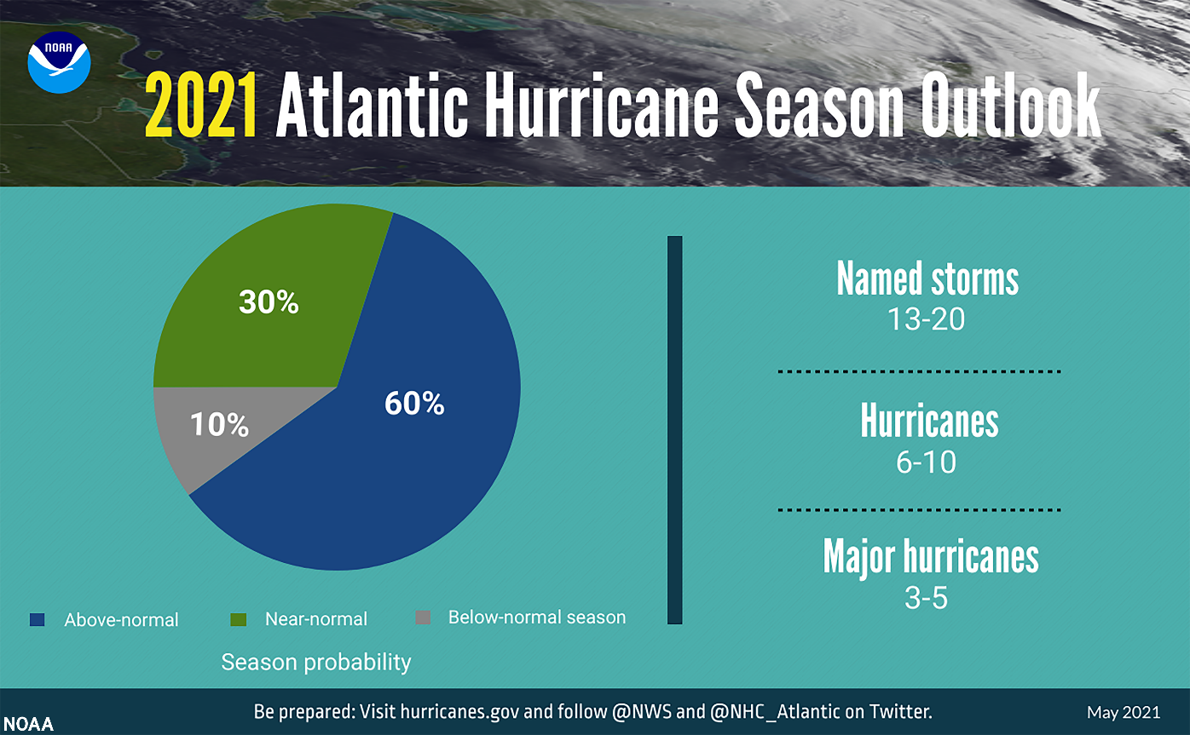
2021 Hurricane Season Update
Notes:
NOAA’s Climate Prediction Center is predicting another above-normal Atlantic hurricane season. Forecasters predict a 60% chance of an above-normal season, a 30% chance of a near-normal season, and a 10% chance of a below-normal season. However, experts do not anticipate the historic level of storm activity seen in 2020.
There will be a range of 13 to 20 named storms (winds of 39 mph or higher), of which 6 to 10 could become hurricanes (winds of 74 mph or higher), including 3 to 5 major hurricanes (category 3, 4 or 5; with winds of 111 mph or higher) is expected. NOAA provides these ranges with a 70% confidence. The Atlantic hurricane season extends from June 1 through November 30.

Slide 46
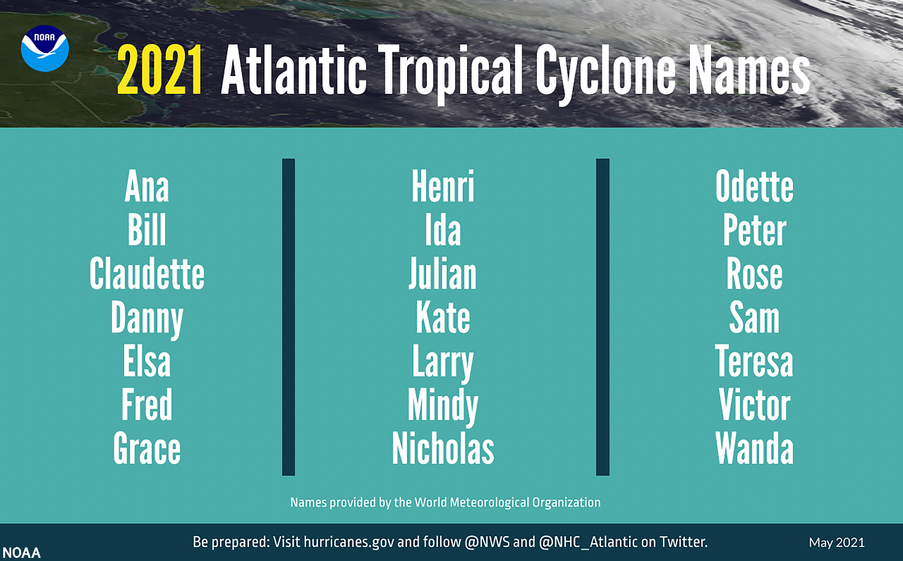
2021 Hurricane Season Update

Slide 47

Disaster preparedness
Preparedness begins with You!
3 Steps to Preparedness
  Have a Plan
  Build a Kit
  Stay Informed
Notes:
LE/Fire train together
Regional Exercises
Annual EOC TTX Training at Executive Level and our ESFs

Slide 48
Have a plan in place
Keep your plan simple.
Keep copies of plan in several places (home, work, kit, etc)
Practice your emergency plan with family members at least twice a year.
Plan for pets/service animals.
Remember – Disaster can happen anytime!
Notes:
LE/Fire train together
Regional Exercises
Annual EOC TTX Training at Executive Level and our ESFs

Slide 49

Build a disaster kit
Water – 1 gallon per person per day for 3 –7 days
Food – for at least 3 – 7 days
First Aid Kit / Medicines/ Prescriptions
Special Items – for babies and elderly
Toiletries
Flashlight / Batteries
Battery powered Radio
NOAA WX Radio
Cash
Important Documents
Pet care Items
Notes:
LE/Fire train together
Regional Exercises
Annual EOC TTX Training at Executive Level and our ESFs

Slide 50
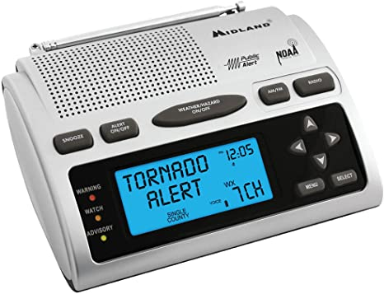
Stay informed
Be sure to watch local news coverage of official press conferences.
For Storm Forecasts, visit https://www.nhc.noaa.gov/
Follow NWS Melbourne on Twitter!
  @NWSMelbourne, https://twitter.com/NWSMelbourne
  https://www.weather.gov/mlb/
Purchase a NOAA Weather Alert Radio.
Notes:
LE/Fire train together
Regional Exercises
Annual EOC TTX Training at Executive Level and our ESFs

Slide 51
Stay informed
Seminole County
  https://www.seminolecountyfl.gov/departments-services/county-managers-office/prepare-seminole/
Orange County
  https://www.orangecountyfl.net/EmergencySafety/EmergencyInformation.aspx#.YKv8AahKgUF
Osceola County
  https://www.osceola.org/agencies-departments/emergency-management/
Notes:
LE/Fire train together
Regional Exercises
Annual EOC TTX Training at Executive Level and our ESFs

Slide 52

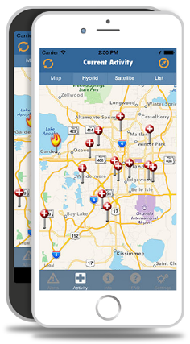
Stay informed
Sign up for a text-based emergency notification system.
  https://www.floridadisaster.org/alertflorida/
Register for your county!
  Seminole: https://member.everbridge.net/index/892807736724714
  Orange: https://member.everbridge.net/index/892807736724714
  Osceola: https://member.everbridge.net/453003085614910
Notes:
LE/Fire train together
Regional Exercises
Annual EOC TTX Training at Executive Level and our ESFs

Slide 53
Reminder
Review
Review plan (annually) & rotate items in kit every (6 months)
Check
Check all perishable items:
batteries,
food,
water,
medicines (over-counter)
Conduct
Conduct emergency drill annually

Slide 54
Unsheltered Count Tutorial
L. Rashad Haynes, Danika Hansen, Tyler Claitt, Christopher Fowler

Slide 55

Announcements!

Slide 56

Need Masks?
HSN has both reusable and disposable masks
Need any? Let us know!
  Contact Christopher.Fowler@hsncfl.org to arrange a pickup

Slide 57
CFCH Partner Employment Opportunities
HCCH/OBFH Open Positions
Licensed Clinical Social Worker
HOPE Team Outreach Specialist
SSVF Outreach Navigator
SSVF Healthcare Navigator
Permanent Supportive Housing Case manager/ Program Support Specialist
For more information about job opportunities, please visit: www.hcch.org

Slide 58

Next Meeting
Tuesday, June 22nd
9 to 10:30 am
Location: Online

