Slide 1

Monthly Members Meeting
August 23rd, 2022

Slide 2

Welcome!

Slide 3
Agenda
Welcome & Introductions
Monkey Pox Guidance
SOAR Refresher Training Promo
Orlando City Emergency Mgmt- Hurricane Preparedness
Hubs, Access Points
Landlord Campaigns
Announcements
New Communications and Public Affairs Director
2022 HUD NOFO

Slide 4

Monkeypox and Persons Experiencing Homelessness
Dr.Pia Valvassori
Health Care Center for the Homeless

Slide 5
Epidemiology
Nationally approximately 13.000 cases
Florida 1300 cases
Central Florida 130 cases
Orange County 90 cases
Most cases in men
Average age 38

Slide 6


Slide 7
Symptoms
Symptoms occur 5-21 days after exposure
High fever,joint pain, enlarged lymph nodes, headache
Rash 1-5 days after onset of symptoms
Rash goes through different phases once scabbed over no longer infectious
Process can take several weeks

Slide 8
Transmission
Transmitted by close contact with rash, scabs, bodily fluid or respiratory droplets
Contact with fabrics-clothing/sheets with fluid from lesions
Virus can live on sheets for up to 15 days

Slide 9
Diagnosis and treatment
Health care workers obtain sample of fluid for testing
Treat symptoms and manage complications and pain
Antivirals for those with weak immune systems

Slide 10
Vaccinations
Indicated for those with known exposure
Persons engaged in sex work/multiple sexual partners
Those with jobs exposing them to monkeypox

Slide 11
Considerations for shelters and encampments
Increased risk of exposure due to close proximity
Suspected cases should be isolated and evaluated
Encourage individuals with symptoms to avoid contact with others, avoiding sharing plates, cups, clothing, towels and other linen
Separate bathroom
Wash clothing and bedding in hot water

Slide 12
Isolation Support
Have food essentials brought to infected resident
Provide phone for telehealth access
Consider behavioral health support for those with substance use disorders and suffering from mental illness
If individual refuses to isolate on site contact public health authority
Provide for PPE for staff and infected resident, lesions should be covered

Slide 13
Resources:
Health Care Center for the Homeless
Harmony Healthcare Orlando
Florida Department of Health

Slide 14

SOAR Refresher Training
Colleen Cantin
Central Florida Cares Health System

Slide 15
SOAR (SSI/SSDI Outreach, Access, and Recovery) for Adults
Substance Abuse and Mental Health Services Administration
(SAMHSA) SOAR Technical Assistance Center
Policy Research Associates, Inc.

Slide 16
What is SOAR?
A model for assisting eligible individuals to apply for Social Security Administration (SSA) disability benefits
For individuals who are experiencing or at risk of homelessness and have a serious mental illness, co-occurring substance use disorder, or other physical disabilities
Sponsored by SAMHSA in collaboration with the Social Security Administration (SSA) since 2005
All 50 states and Washington, DC currently participate

Slide 17
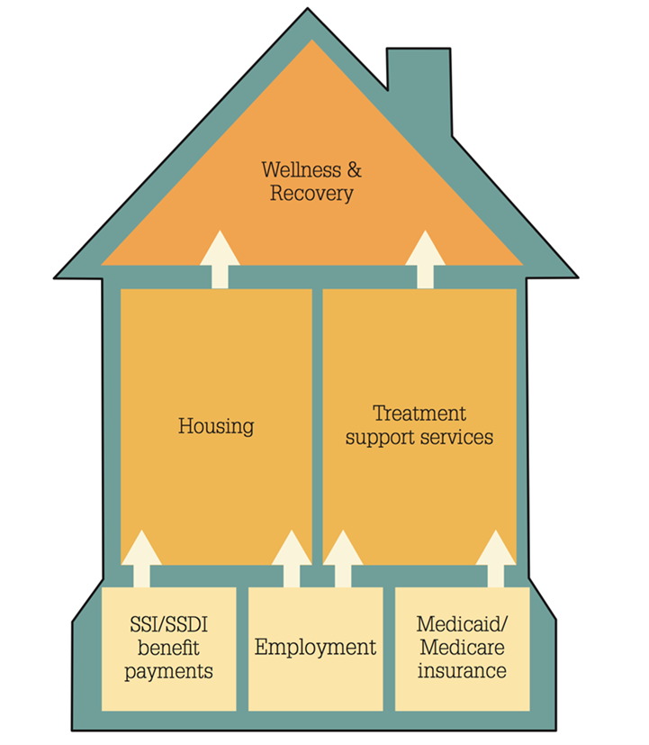
A Foundation for Recovery and Resiliency
More Than Income
SSI/SSDI: One Brick in Foundation
Access to health care and housing
Increased education and employment opportunities
Decrease in incarcerations and hospitalizations

Slide 18
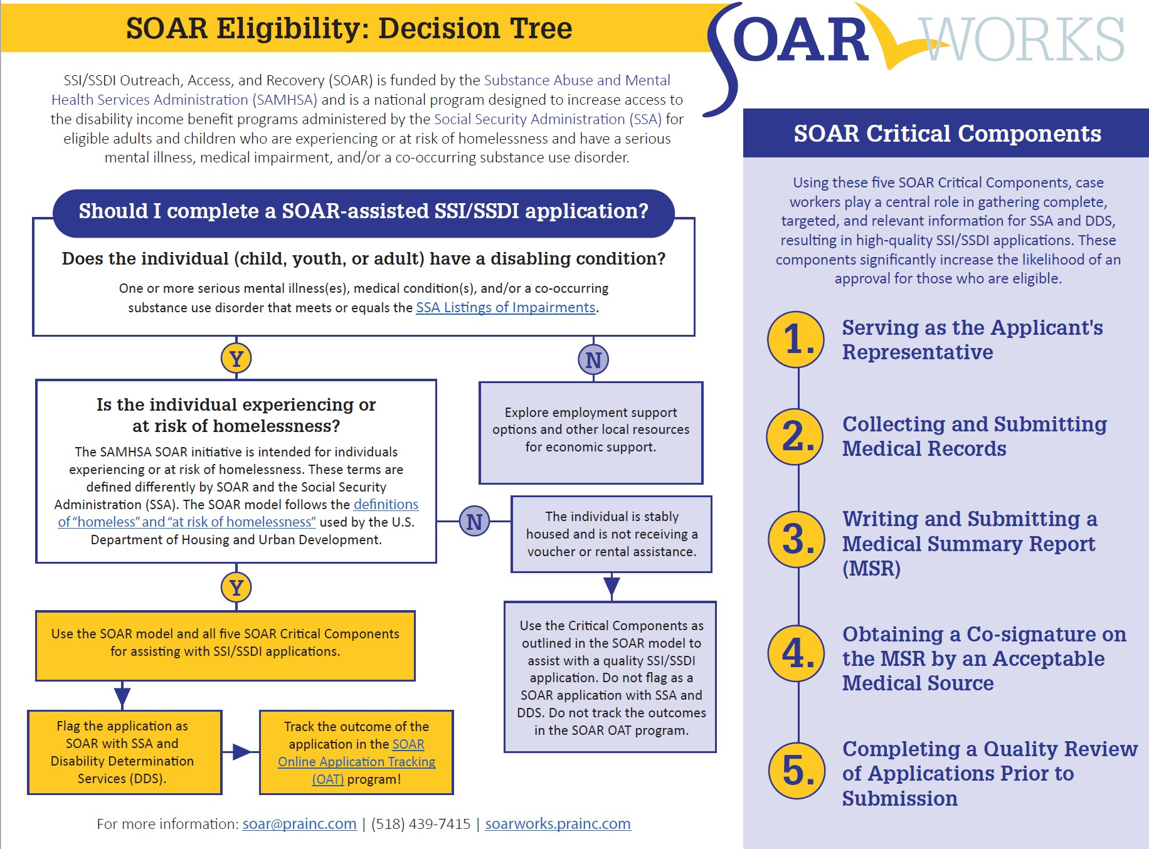
SOAR Eligibility: Decision Tree

Slide 19
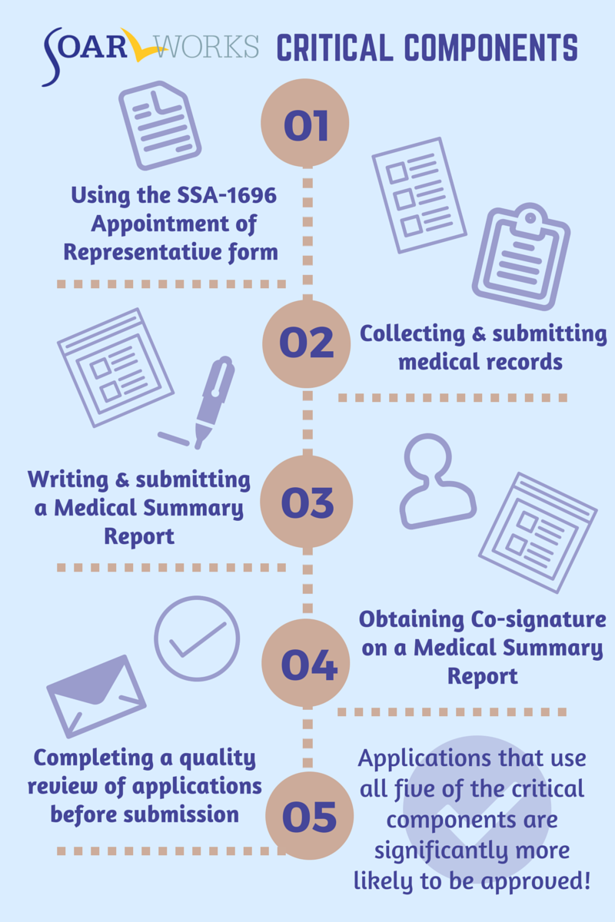

What Makes SOAR Unique?
SOAR-trained case workers are the heroes!

Slide 20
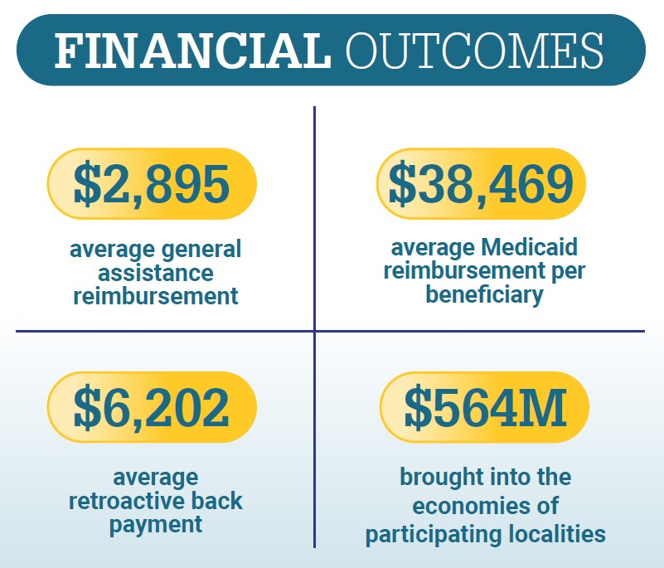
2021 Financial Outcomes

Slide 21
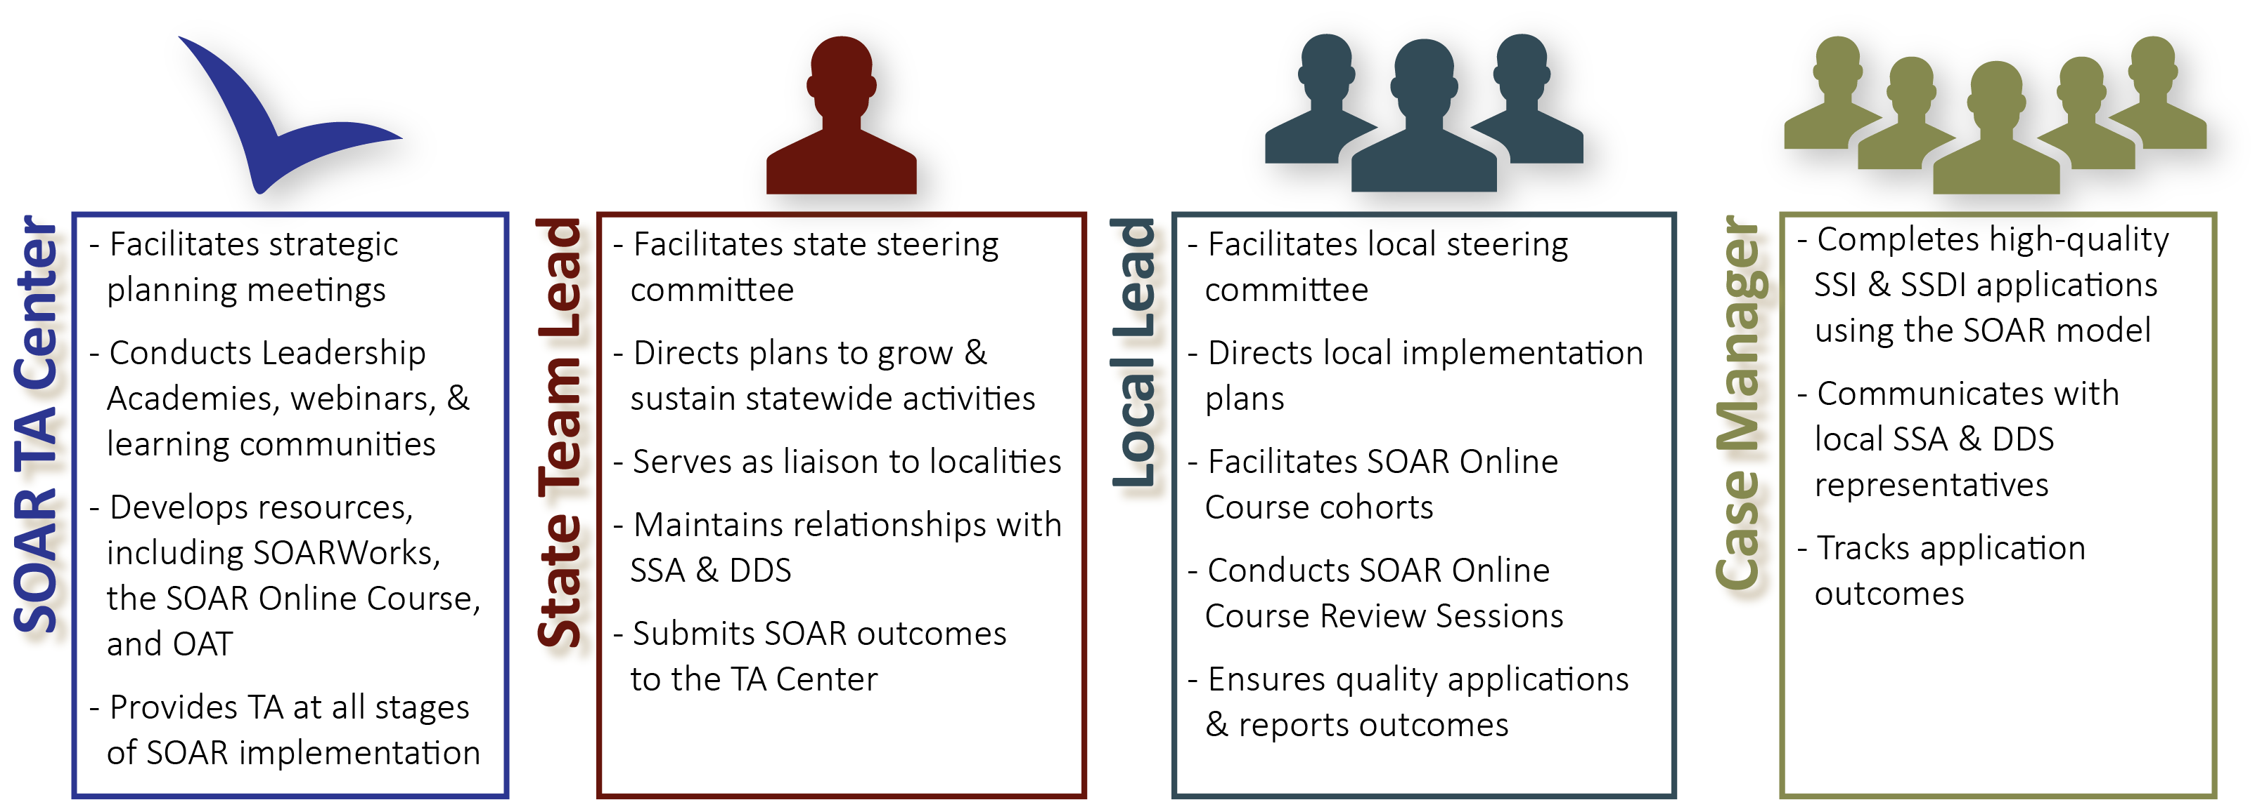
SOAR Leadership Structure
*OAT: Online Application Tracking Program
*DDS: Disability Determination Services
*TA: Technical Assistance
Notes:
Be sure to mention that case managers might have an agency lead that uses OAT and helps supervise multiple case managers
All these players are ambassadors for SOAR Initiative – united in ending homelessness for individuals with disabling conditions

Slide 22

Benefits of the SOAR Online Courses
Standardized training provided across all geographic areas
SOAR Leaders can coordinate follow-up training and support
Courses are FREE, web-based, and self-guided
20 CEUs from National Association of Social Workers (NASW)

Slide 23
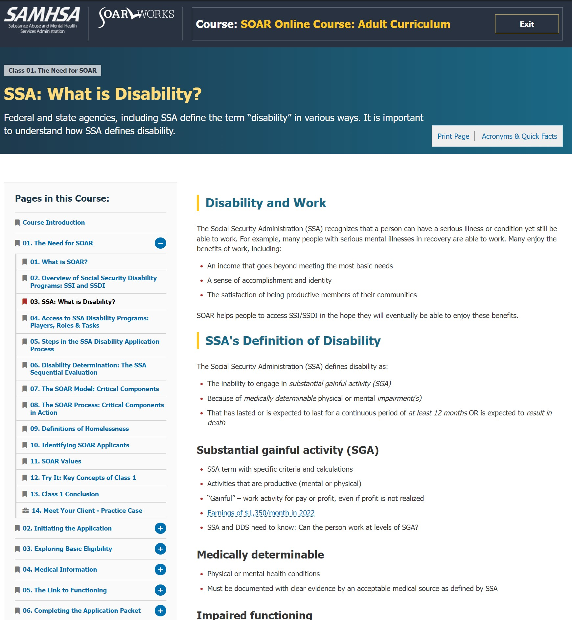
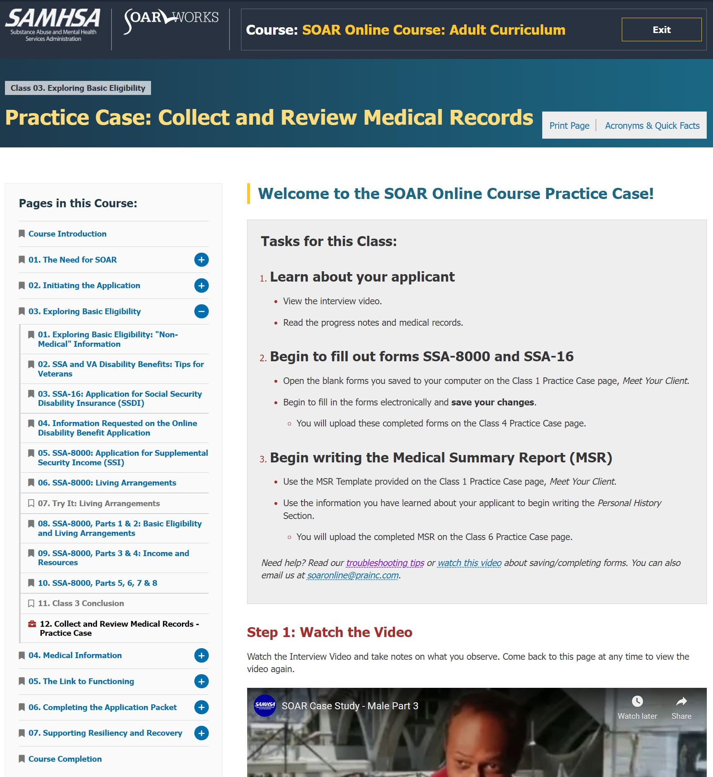
SOAR Online Course: Articles and Practice Case
Articles and Content
Practice Case
Notes:
Articles v Practice Case files
7 Classes that cover everything from the basics of SSI/SSDI and SOAR to Work Incentives
Unique Practice Case Component – trainees complete an SSI/SSDI application packet for a fictional applicant

Slide 24
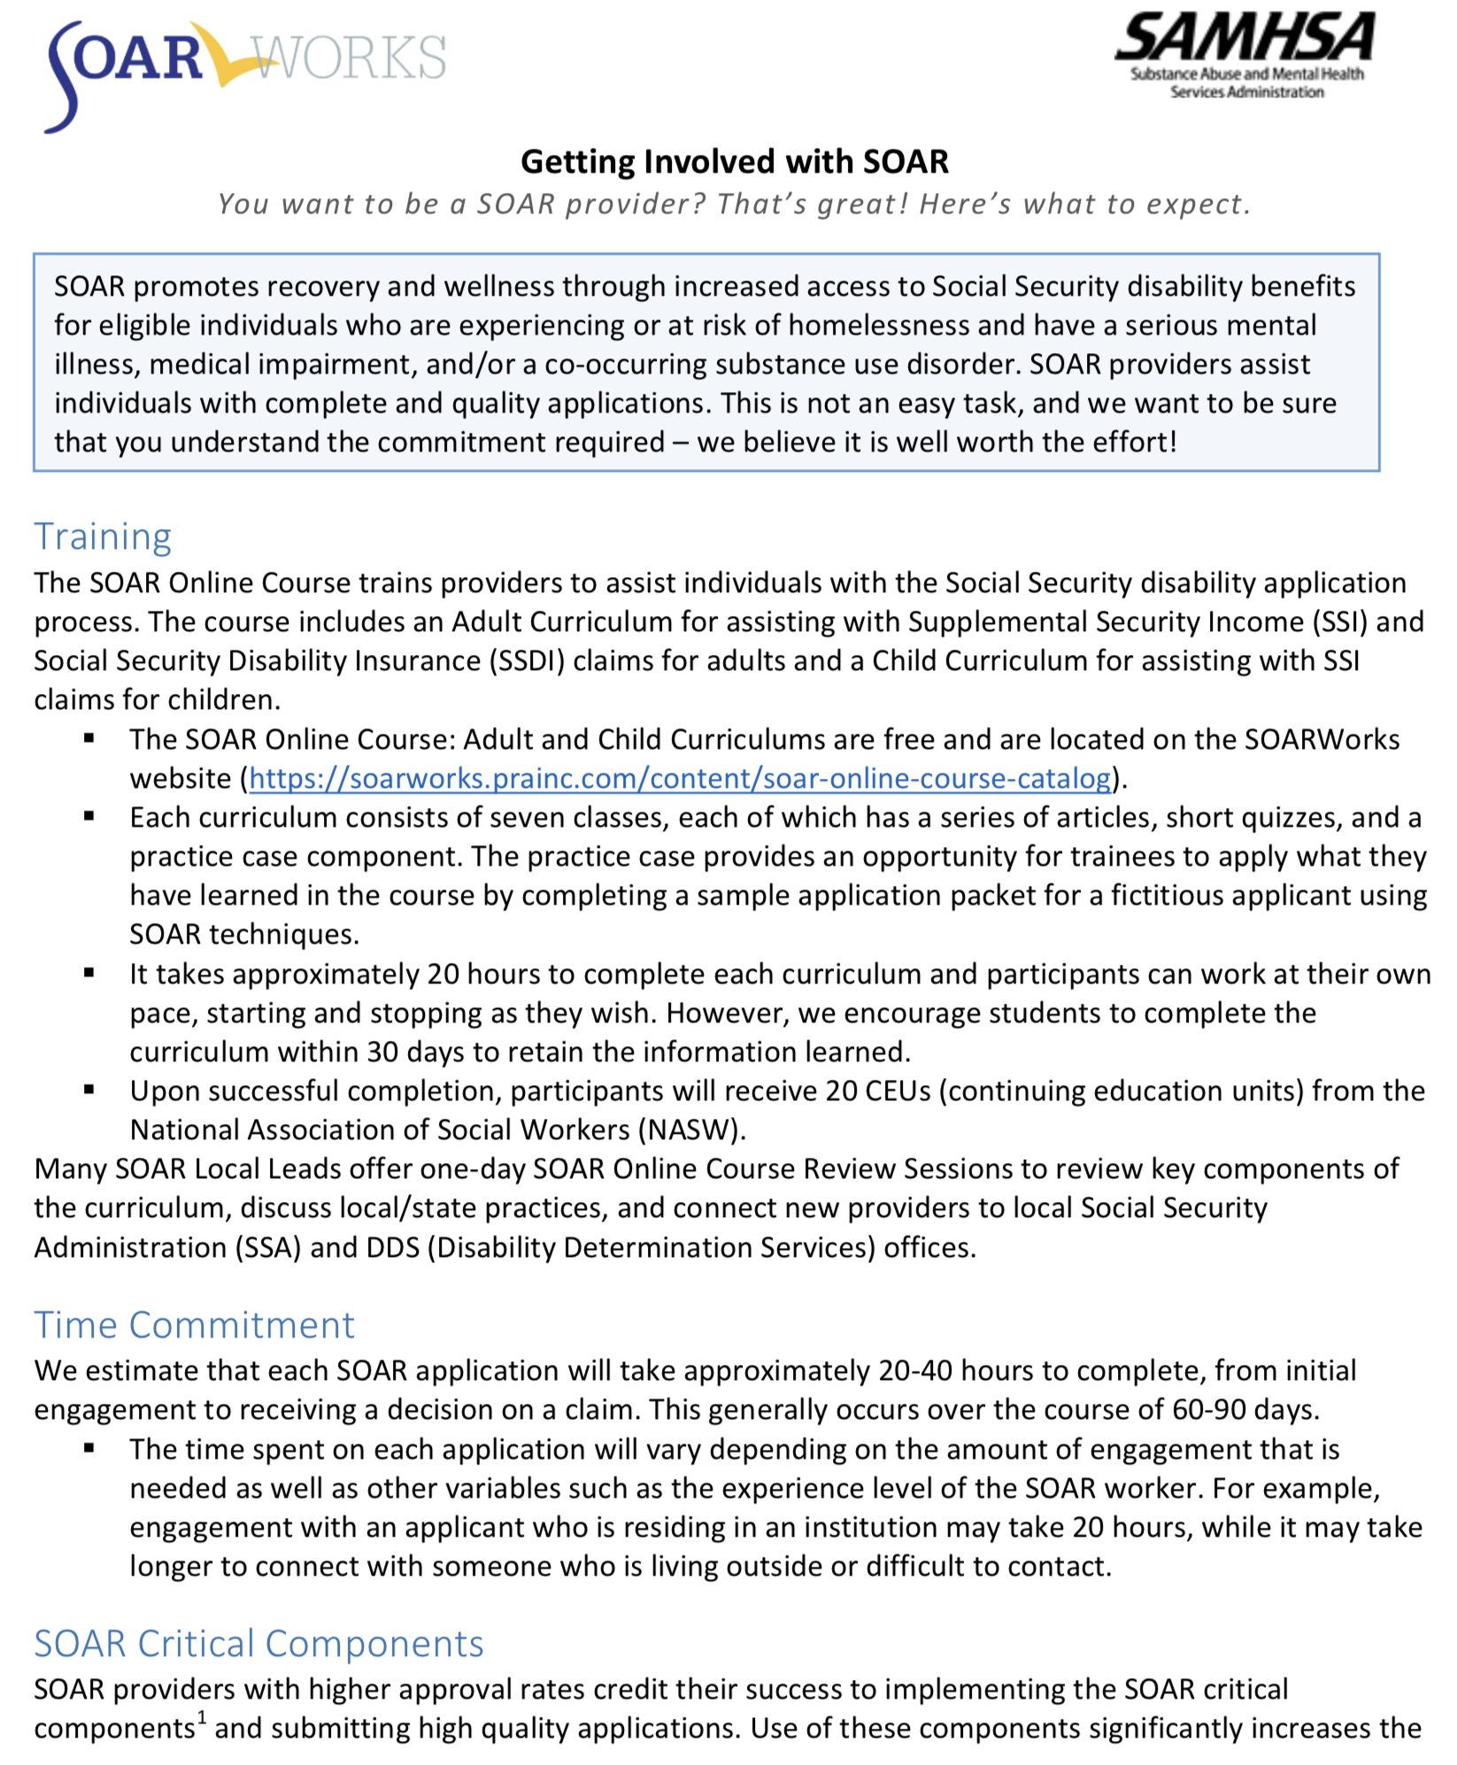
Getting Involved: Time Commitment
Training: 20 hours
20-40 hours per complete application
SOAR Critical Components
Outcome Tracking
Benefit to Your Agency and the Individuals You Serve

Slide 25
2021 Financial Outcomes

Slide 26

Online Application Tracking (OAT)
Web based
User friendly
HIPAA compliant
Monitors quality
Takes only 3-5 minutes
It’s FREE!
All the reasons OAT is awesome!
https://soartrack.samhsa.gov

Slide 27
Next Steps
Reach out to your local or state SOAR leads
Register for the SOAR Online Course
Colleen Cantin
ccantin@cfchs.org
407-867-0881

Slide 28
WELCOME KATE SANTICH
COMMUNICATIONS
&
PUBLIC AFFAIRS DIRECTOR

Slide 29
2022 HUD NOFO
Martha Are,
HSN

Slide 30
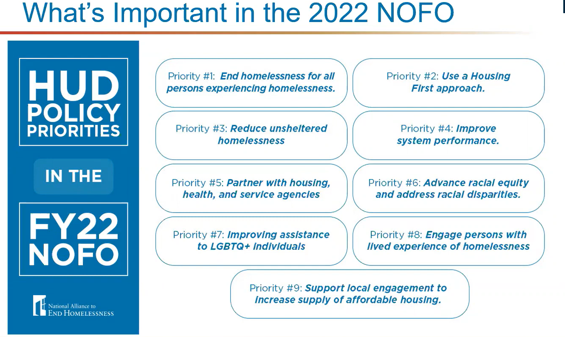

Slide 31
Three Step Process
Step 1: HUD tells us how much funding we can request, which is based on what was awarded last year
  Tier 1
    Requires the lowest threshold score, but still must score that threshold
    Covers 95% of the projects funded the previous year
  Tier 2/Bonus
    Requires a higher score
    Covers the remaining 5%
    May provided additional funding
Step 2: The region conducts a local application process to determine which projects will be included in the federal submission to HUD
Step 3: Region submits project applications as part of a larger application to HUD

Slide 32
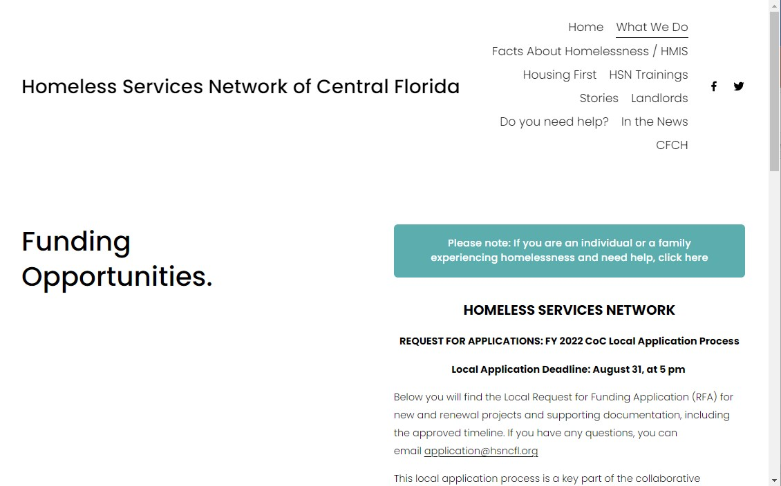
Step 2 – The Local Application Process
https://hsncfl.org/funding

Slide 33
Step 2 Timeline
Applications Due from Applicants | Applicants | August 31 5:00 PM | Renewal and New Applications must be submitted to application@hsncfl.org
Volunteer Reviewers submit scores | Independent Reviewers | September 8
Ranking Committee Meeting | Community Ranking Committee | September 12/13 | Committee develops funding recommendation for CoC Board approval
Managing (CoC) Board Meeting | CoC Board | September 14 | CoC Board receives and votes on Ranking Committee recommendations
Funding Recommendation Notification | Applicants, public | September 15 | Applicants notified of funding recommendations (both selected and not selected for funding)

Slide 34
Project Type
PSH: has to be for persons experiencing chronic homelessness
RRH: families, youth, victim services
Transitional Housing: youth renewal only
Joint TH/PH-RRH: intended for youth or victim services

Slide 35
Scoring
Not all scoring comes from the answers to the questions in this application
Additional scores will come from administrative and HMIS data

Slide 36
Due Date ….. New and Renewals
August 31, 2022
5:00 PM
You will be notified no later than September 15

Slide 37
Questions?

Slide 38

Welcome!
General Disaster Preparedness
Manuel D. Soto, CEM Emergency Manager
Notes:
Emergency Management Perspective and our roles in support of the incident
DRAFT

Slide 39
Agenda
Emergency Management Program Awareness
Emergency Management
EM Responsibilities
Emergency Preparedness
Community Involvement
Notes:
Things that we observed and learned

Slide 40



  “One of America’s ten coolest cities, citing Orlando’s
  number of night life, cultural and recreational outlets”
  Forbes Magazine
  Strong Mayor form of government
3,300 employees/$1.2 billion annual budget
265,000 annual residents (28% Hispanic and 27% Black)
Forbes ranked Orlando 35th on their list of America’s safest cities
Notes:
DRAFT
Orlando International Airport visitors – over 60 million annually
Disney
Universal Studios
SeaWorld
MLS Soccer
Magic Basketball
2nd Largest University
Our economy depends on tourism
Strong commitment to public safety from Mayor and city leadership

Slide 41
What is Emergency Management?
is the coordination to preparedness, response, recovery and mitigation to any size emergencies, disasters, planned events or catastrophic incidents.
Notes:
LE/Fire train together
Regional Exercises
Annual EOC TTX Training at Executive Level and our ESFs

Slide 42
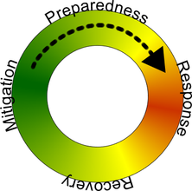
How Emergency management works?
Preparedness is aimed at preventing
a disaster from occurring
Mitigation is mainly about knowing and avoiding unnecessary risks
Response phase of an emergency occurs and local first responder respond to assist
Recovery phase starts after the immediate threat to human life has subsided
Notes:
LE/Fire train together
Regional Exercises
Annual EOC TTX Training at Executive Level and our ESFs

Slide 43

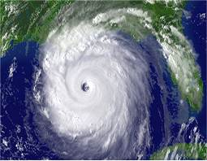

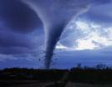


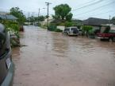
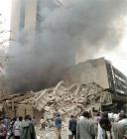
Emergency management prepares for all hazards
Notes:
LE/Fire train together
Regional Exercises
Annual EOC TTX Training at Executive Level and our ESFs

Slide 44
City of Orlando emergency management team
The City’s Emergency Management Team is comprised of the 13 departments of City of Orlando.
Other Disaster Response Partners include but are not limited to:
  American Red Cross
  Theme Parks
  Orange County Office of Emergency Management
  LYNX
  Orlando/Orange County Convention and Visitors Bureau
  Greater Orlando Aviation Authority
  UCF, and Valencia Community College
  Many others
Notes:
LE/Fire train together
Regional Exercises
Annual EOC TTX Training at Executive Level and our ESFs

Slide 45

Office of emergency management
Mission
The Office of Emergency Management's (OEMs) mission is to save lives and protect property.
  - We accomplish this through the development of programs, coordinated management, and the support of operational capabilities.
Notes:
LE/Fire train together
Regional Exercises
Annual EOC TTX Training at Executive Level and our ESFs

Slide 46
OEM Responsibilities
The office manages and oversees the following programs:
Planning/Mitigation
Communications/Warning
Training and Exercises
Homeland Security
Public Outreach
Emergency Shelters Coordination
Grants Administration
Notes:
LE/Fire train together
Regional Exercises
Annual EOC TTX Training at Executive Level and our ESFs

Slide 47
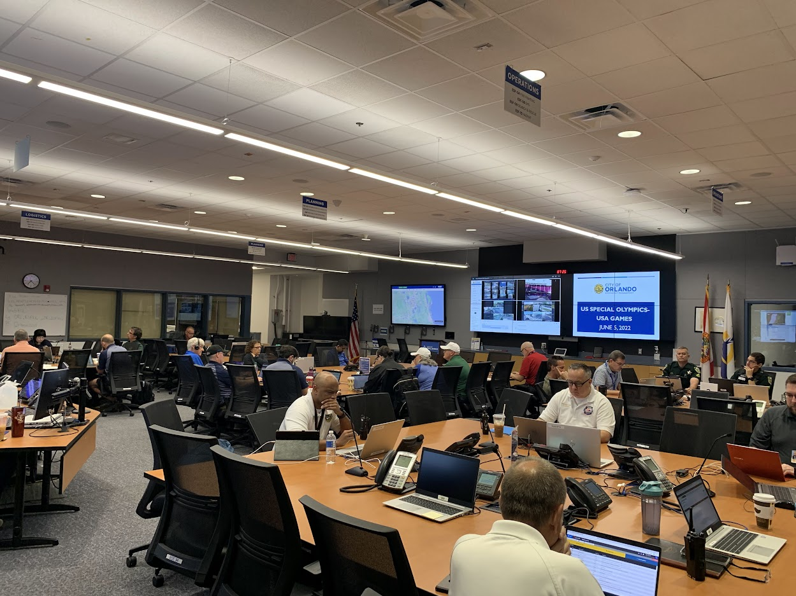
Emergency operations center
Notes:
LE/Fire train together
Regional Exercises
Annual EOC TTX Training at Executive Level and our ESFs

Slide 48
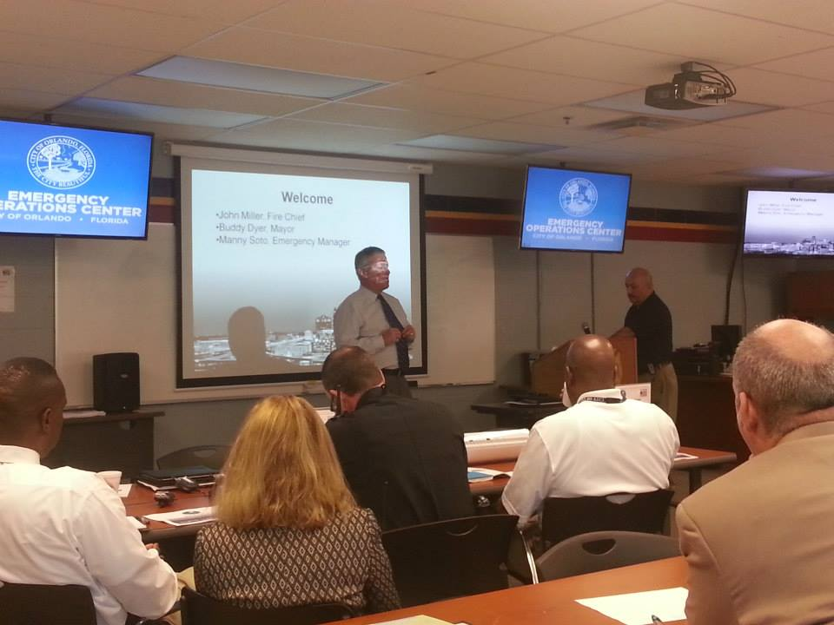
Alternate Emergency operations center
Notes:
LE/Fire train together
Regional Exercises
Annual EOC TTX Training at Executive Level and our ESFs

Slide 49
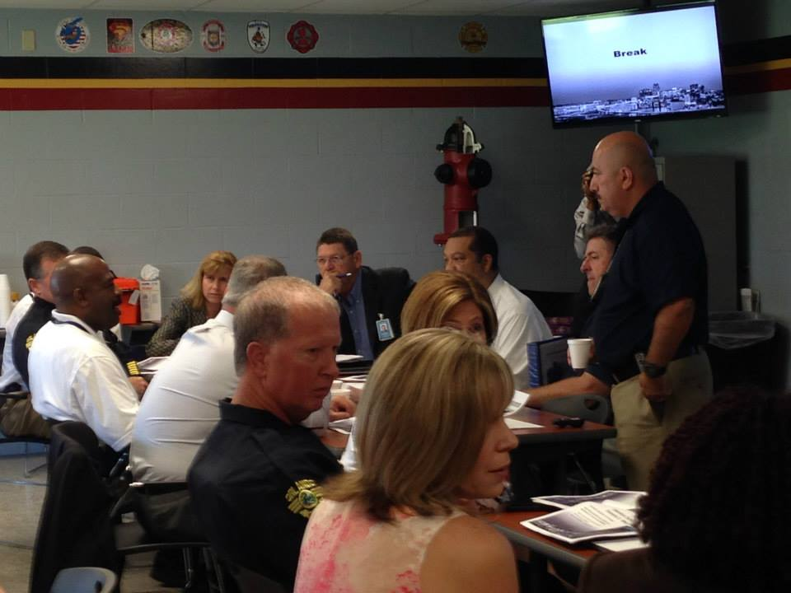
Alternate Emergency operations center
Notes:
LE/Fire train together
Regional Exercises
Annual EOC TTX Training at Executive Level and our ESFs

Slide 50
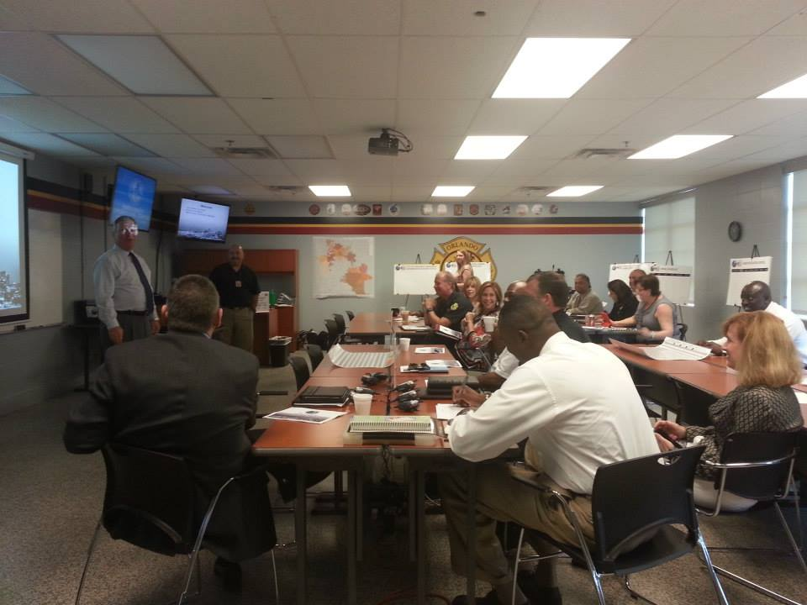
Alternate Emergency operations center
Notes:
LE/Fire train together
Regional Exercises
Annual EOC TTX Training at Executive Level and our ESFs

Slide 51
EM Mission Ready
Prepared –
          Plans & Procedures,
          Train & Exercise Personnel,
          Available Supplies & Equipment
Respond –
          Process and Procedures
          Staff/Team Assignments
          Position Responsibilities
Recover –
          Plan to Return to Normal
          Procedures to Request Assistance
Notes:
LE/Fire train together
Regional Exercises
Annual EOC TTX Training at Executive Level and our ESFs

Slide 52
EM Mission Ready
Business –
          Private and Non-Governmental,
          Partnership with Local Government,
          Available/Needed Resources
Notification –
          Warning/Watch Notice
          Staff/Team Early Warnings
          Designated Duty Officer
Operations –
          Operation Procedures
          Designated Assignments
Notes:
LE/Fire train together
Regional Exercises
Annual EOC TTX Training at Executive Level and our ESFs

Slide 53
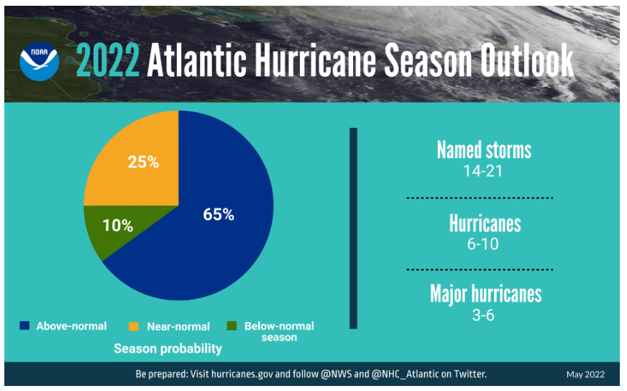
2022 Hurricane Season Update
Updated from CSU on April 7, 2022
Notes:
LE/Fire train together
Regional Exercises
Annual EOC TTX Training at Executive Level and our ESFs

Slide 54
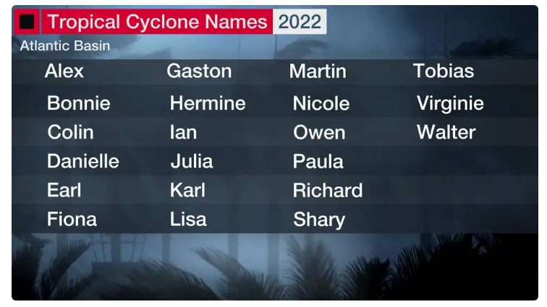
2022 Hurricane Season Update
Notes:
LE/Fire train together
Regional Exercises
Annual EOC TTX Training at Executive Level and our ESFs

Slide 55

Disaster preparedness
Preparedness begins with You!
3 Steps to Preparedness
  Make a Plan
  Build a Kit
  Get Informed
Notes:
LE/Fire train together
Regional Exercises
Annual EOC TTX Training at Executive Level and our ESFs

Slide 56
Make a plan
Keep your plan simple.
Keep copies of plan in several places (home, work, kit, etc)
Practice your emergency plan with family members at least twice a year.
Plan for pets/service animals.
Remember – Disaster can happen anytime!
Notes:
LE/Fire train together
Regional Exercises
Annual EOC TTX Training at Executive Level and our ESFs

Slide 57
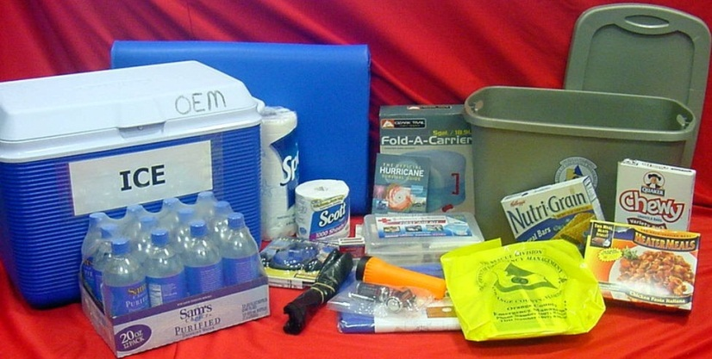
Build a disaster kit
Water – 1 gallon per person per day for 3 –7 days
Food – for at least 3 – 7 days
First Aid Kit / Medicines/ Prescriptions
Special Items – for babies and elderly
Toiletries
Flashlight / Batteries
Battery powered Radio
NOAA WX Radio
Cash
Important Documents
Pet care Items
Notes:
LE/Fire train together
Regional Exercises
Annual EOC TTX Training at Executive Level and our ESFs

Slide 58

Get informed
Be sure to watch local news coverage of official press conferences.
Purchase a NOAA Weather Alert Radio.
During a disaster (for information) visit our website at: www.cityoforlando.net/
Or www.facebook.com/cityoforlndo and www.twitter.com/cityoforlando
Notes:
LE/Fire train together
Regional Exercises
Annual EOC TTX Training at Executive Level and our ESFs

Slide 59

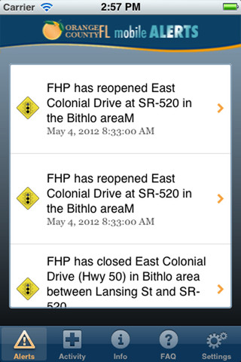
Get informed
OCAlert.Net
Text-based emergency notification system. Citizens can register at: http://ocalert.net
OCFL Alert Apps
We have apps for iPhones and Android available at the apps stores.
Notes:
LE/Fire train together
Regional Exercises
Annual EOC TTX Training at Executive Level and our ESFs

Slide 60
reminders
Review plan (annually) & rotate items in kit every (6 months)
Check all perishable items:
  batteries,
  food,
  water,
  medicines (over-counter)
Conduct drill annually
Notes:
LE/Fire train together
Regional Exercises
Annual EOC TTX Training at Executive Level and our ESFs

Slide 61
conclusion
Thank You!
Manuel D. Soto
Emergency Manager
City of Orlando
manuel.soto@cityoforlando.net
Notes:
LE/Fire train together
Regional Exercises
Annual EOC TTX Training at Executive Level and our ESFs

Slide 62

Notes:
DRAFT

Slide 63

Access Points

Slide 64
What is an Access Point?
An Access Point is a place and/or a person where anyone experiencing a housing crisis can report to, to see what resources are available; aimed at ensuring that all people in the community have equal access to resources in the Continuum of Care (CoC). All Access Points offer the opportunity for Diversion conversations and Assessments.

Slide 65
Examples of Access Points
211
HUBs
Emergency Shelters
Street Outreach Members
Other Homeless Management Information System (HMIS) Users

Slide 66

Role in the Coordinated Entry System
Access Points play a critical role in the beginning to determine which intervention might be most appropriate to rapidly connect someone to housing.
Access Points are low barrier and provide fair and equal access to the Coordinated Entry System.

Slide 67
How to become an Access Point?
If your organization would like to become an Access Point, you will need to do the following:
Go to cfch.org.
Select “Sign Up for Updates” in the upper right hand corner of the webpage.
Enter the requested information to join the mailing list.
Stay tuned for the HSN newsletter with further information in the near future!

Slide 68
What do I tell someone who is looking for resources in the meantime?
Contact 211
Visit hsncfl.org for information on HUB locations
Or report to a HUB at one of the following locations:
Christian Service Center 808 W. Central Blvd Orlando Fl, 32805 Every Friday
9:30am to 12:30pm
United Against Poverty 150 W. Michigan St.
Orlando Fl, 32806 Every Friday 1:30pm to 4:00pm
Sharing Center (Oasis) 600 N. U.S. Hwy 17-92
Longwood Fl, 32750 Monthly, Fourth Monday 9:00am to 10:30am
Hope Partnership 122 W. Sproule Ave. Kissimmee Fl, 34741 First and Third Thursday of Every Month
1:00pm to 3:00pm
VA Medical Center 5201 Raymond St.
Orlando Fl, 32803
First and Third Friday of Every Month
9:00am to 2:00pm

Slide 69
Q&A

Slide 70


Slide 71

Announcements!

Slide 72


Slide 73


Slide 74

Need PPE?
Let HSN meet your PPE needs!
Reusable and Disposable Masks
Hand Sanitizer
Gloves
Need any? Let us know!
Contact Christopher.Fowler@hsncfl.org to arrange a pickup

Slide 75

Next Meeting:
Tuesday, September 27th, 2022
9 to 10:30 am
Location: Online

